Slide 1
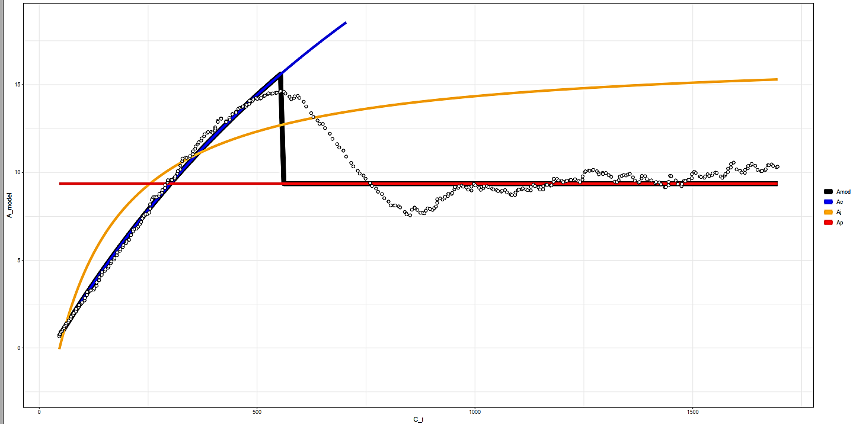

K6706L1
15
10
Modeled A
5
Amod
Ac
Aj
Ap
0
0
500
1000
1500
$$C_{i}$$

Slide 2
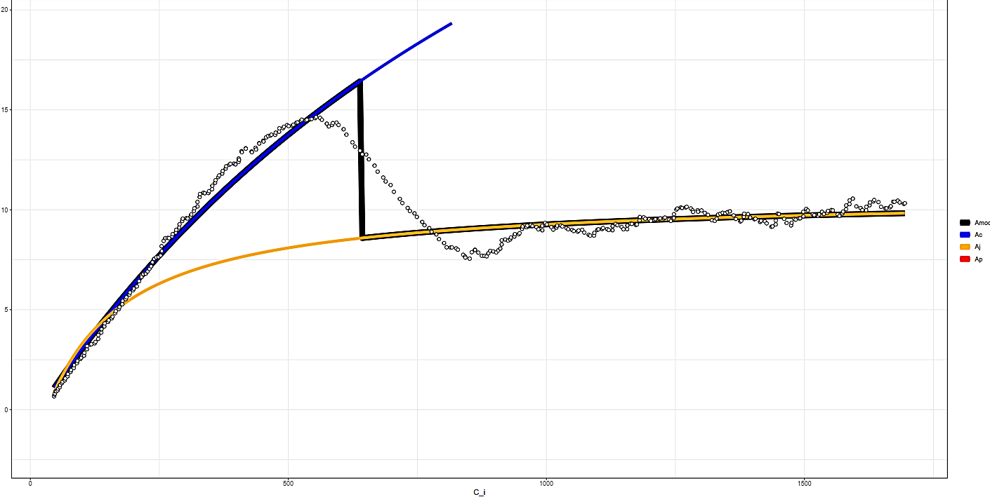

K6706L1
15
10
Modeled A
5
Amod
Ac
Aj
Ap
0
0
500
1000
1500
$$C_{i}$$

Slide 3
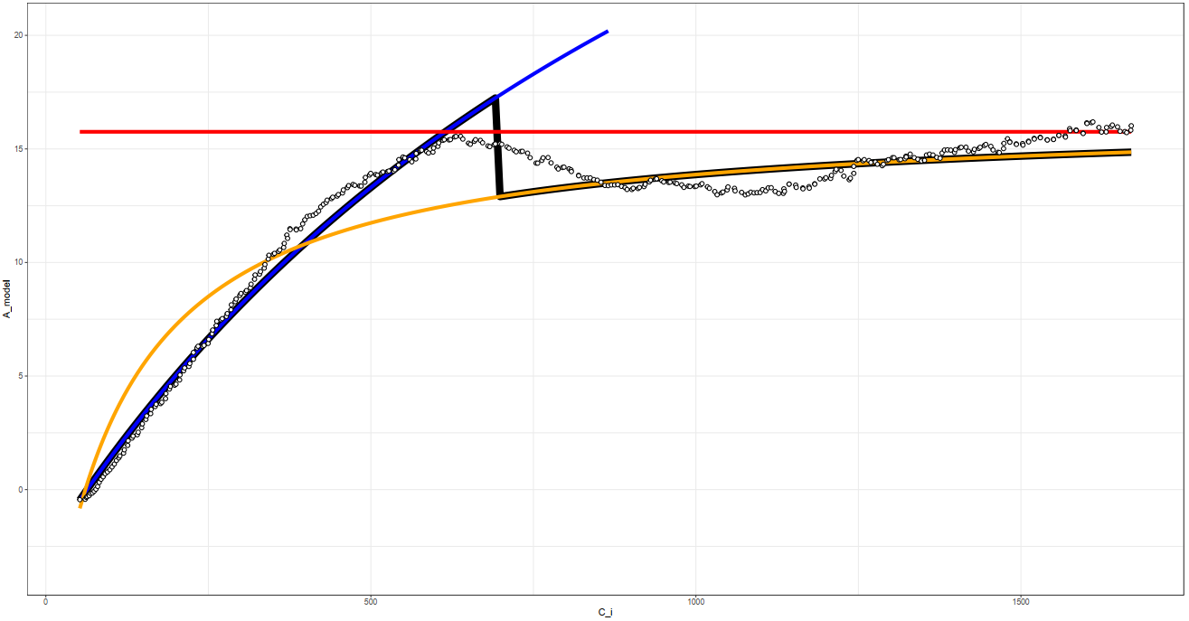

K6706L2
20
15
Modeled A
10
5
Amod
Ac
Aj
Ap
0
0
500
1000
1500
$$C_{i}$$

Slide 4
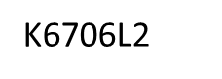
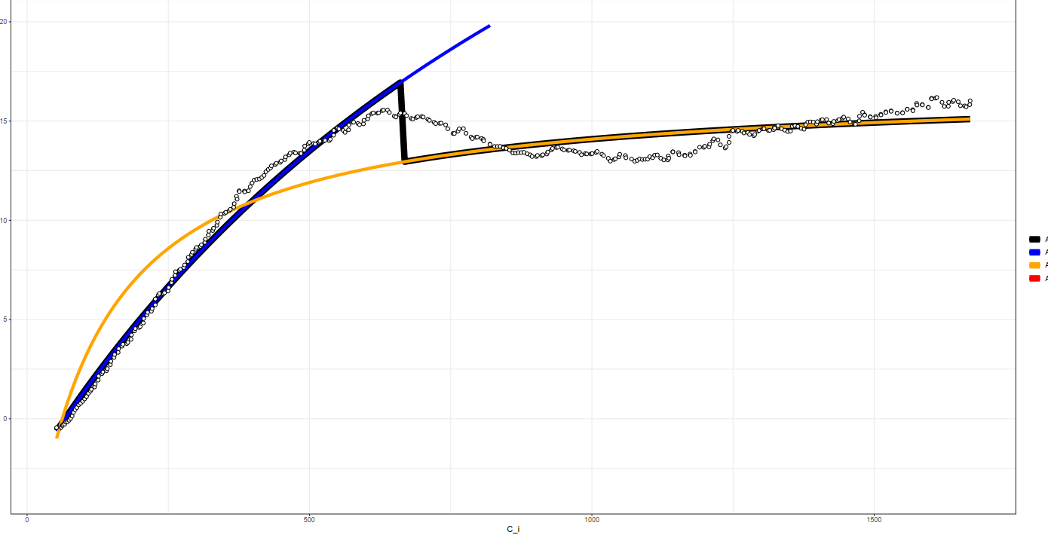
20
15
Modeled A
10
5
Amod
Ac
Aj
Ap
0
0
500
1000
1500
$$C_{i}$$

Slide 5
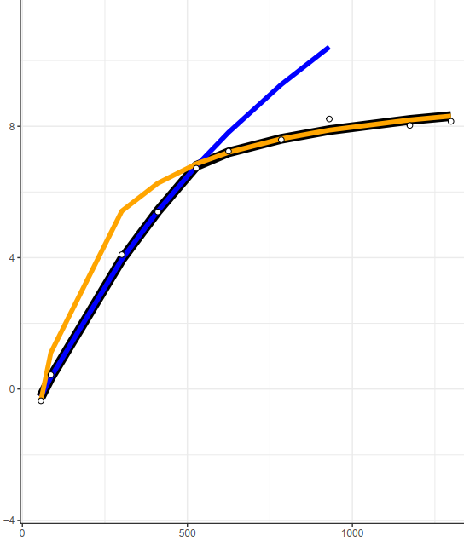
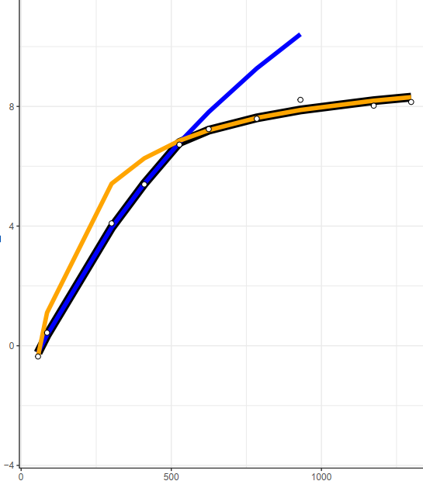
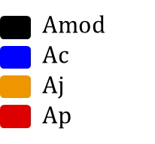
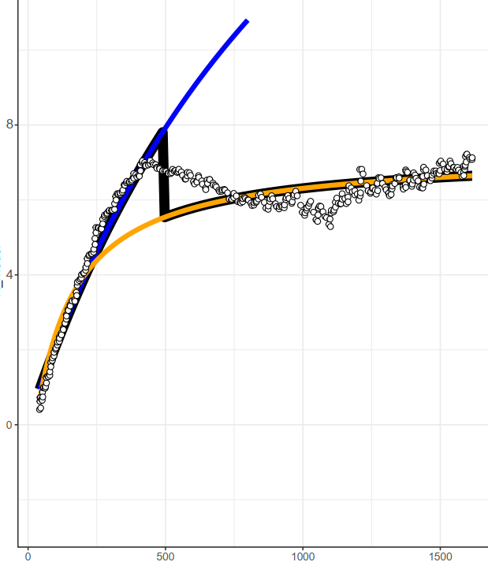
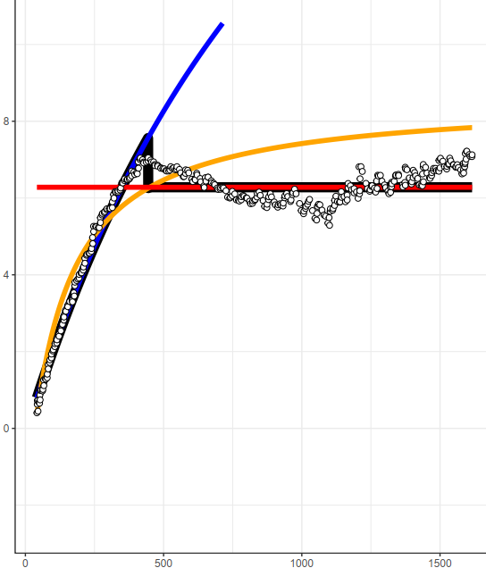


K6702L1
Without TPU
With TPU
Steady-State
Modeled A
DAT
Modeled A
$$C_{i}$$
$$C_{i}$$

Slide 6
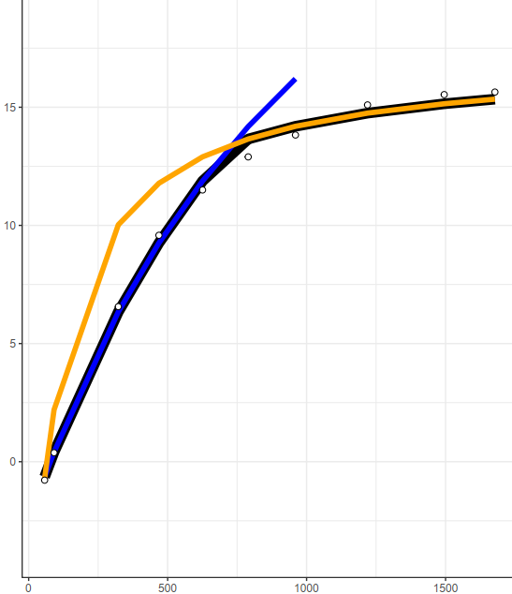

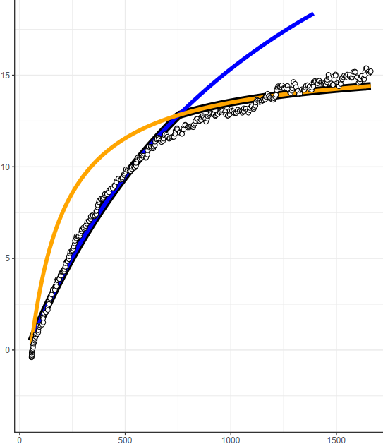
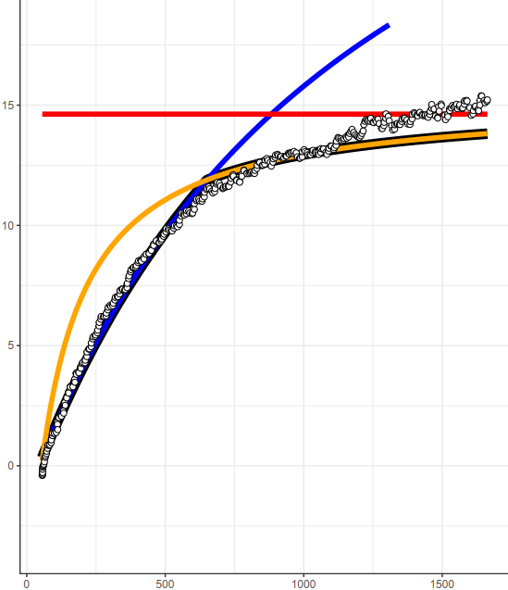
K6704L1
Without TPU
With TPU
Steady-State
Modeled A
DAT
Modeled A
$$C_{i}$$
$$C_{i}$$

Slide 7
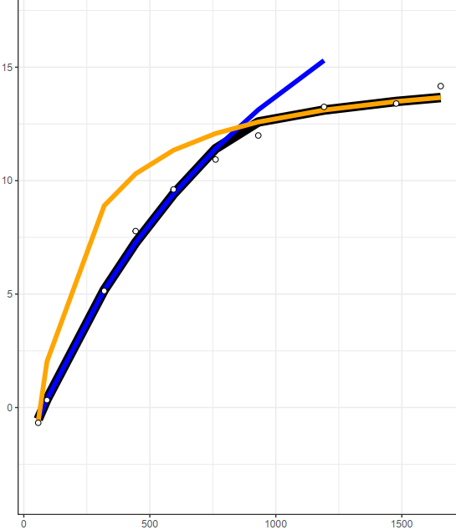

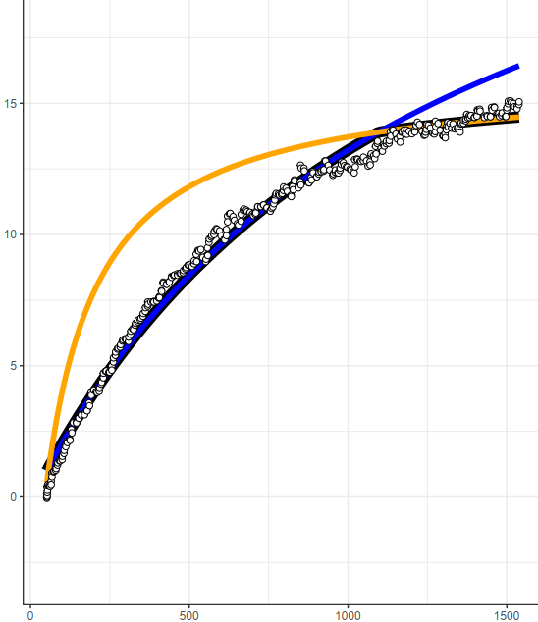
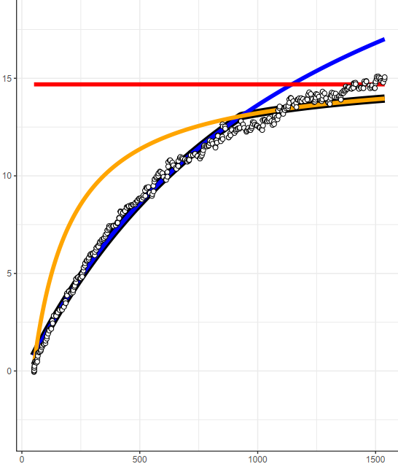
K6704L2
Without TPU
With TPU
Steady-State
Modeled A
DAT
Modeled A
$$C_{i}$$
$$C_{i}$$

Slide 8
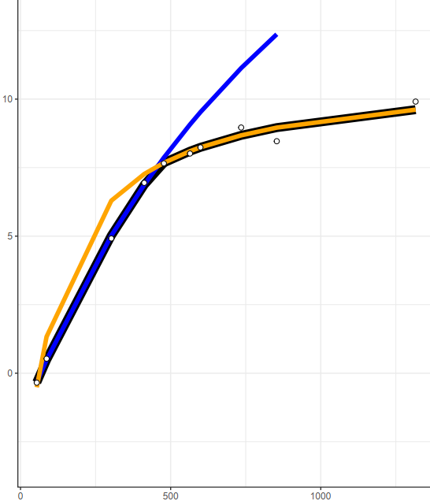
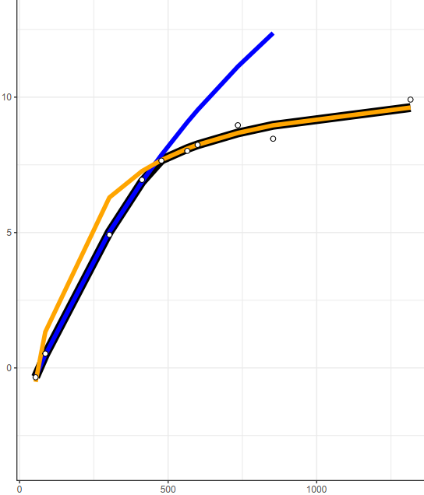
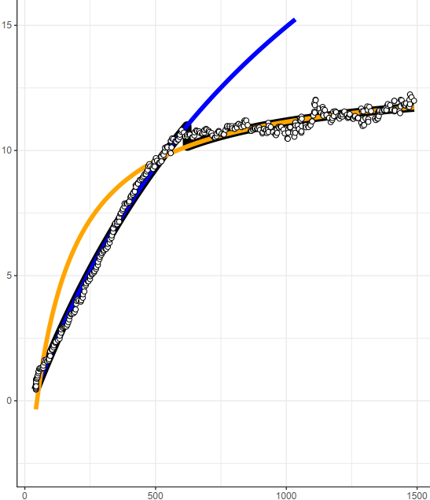
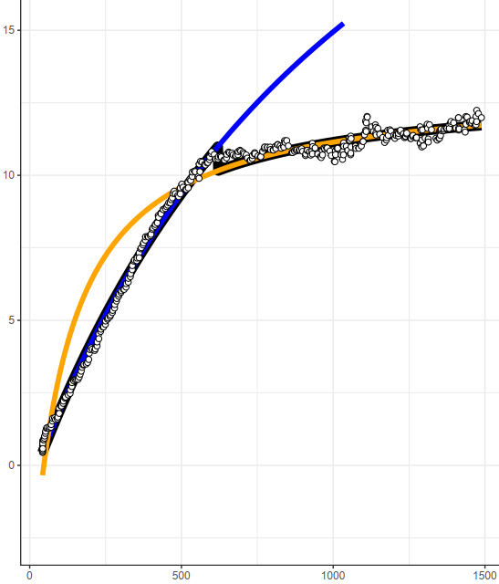
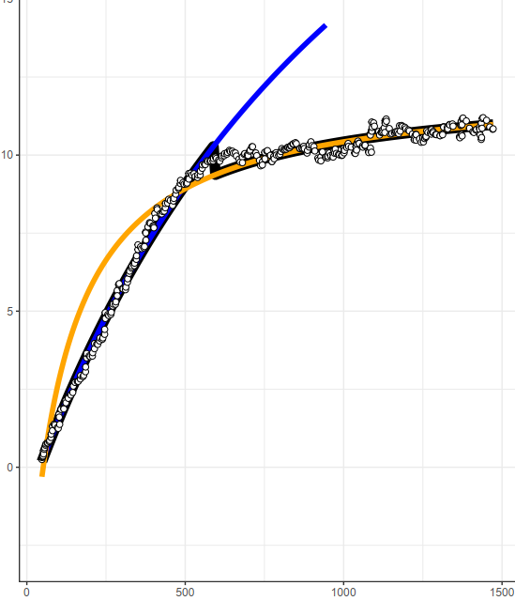



K6705L1
Without TPU
With TPU
Steady-State
Modeled A
Modeled A
DAT
Modeled A
$$C_{i}$$
$$C_{i}$$

Slide 9
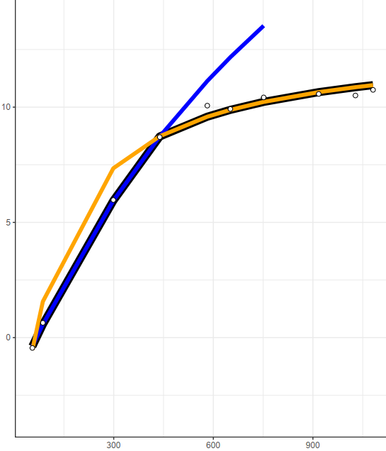
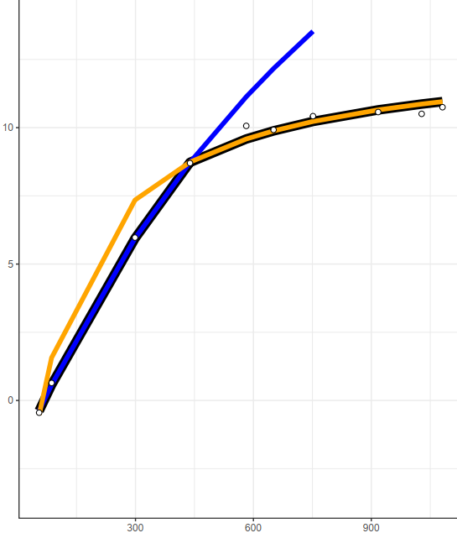
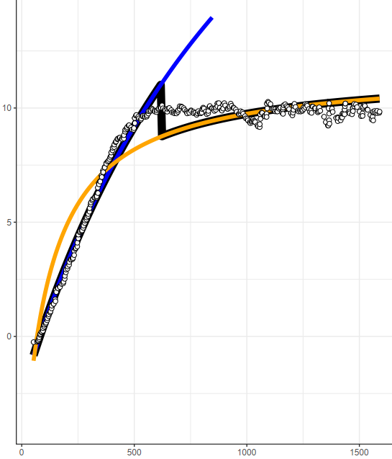
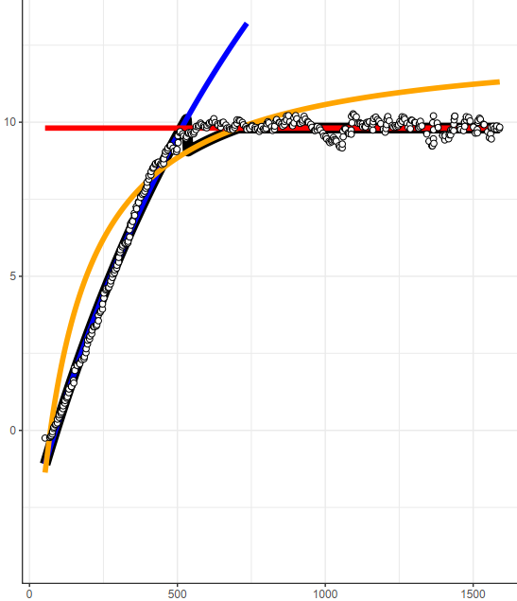
K6705L2
Without TPU
With TPU
Steady-State
Modeled A
DAT
Modeled A
$$C_{i}$$
$$C_{i}$$

Slide 10
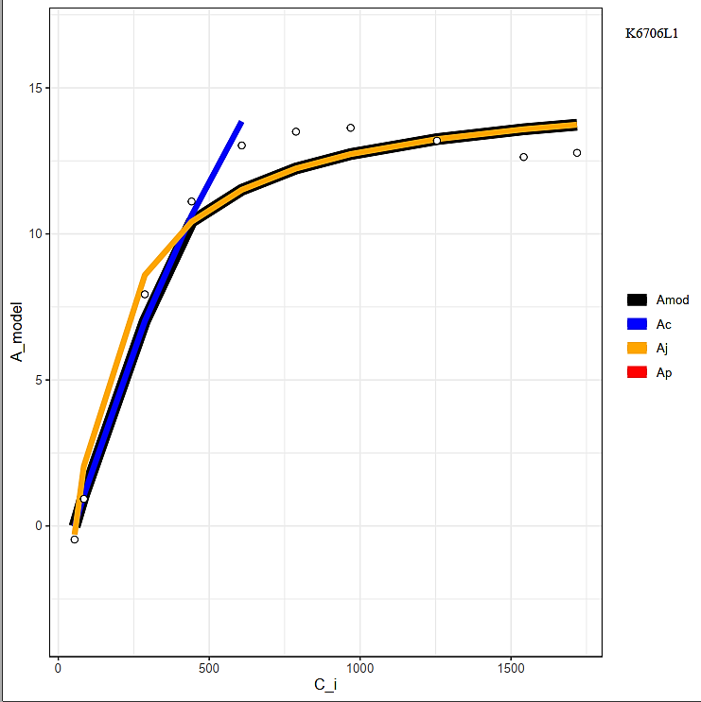
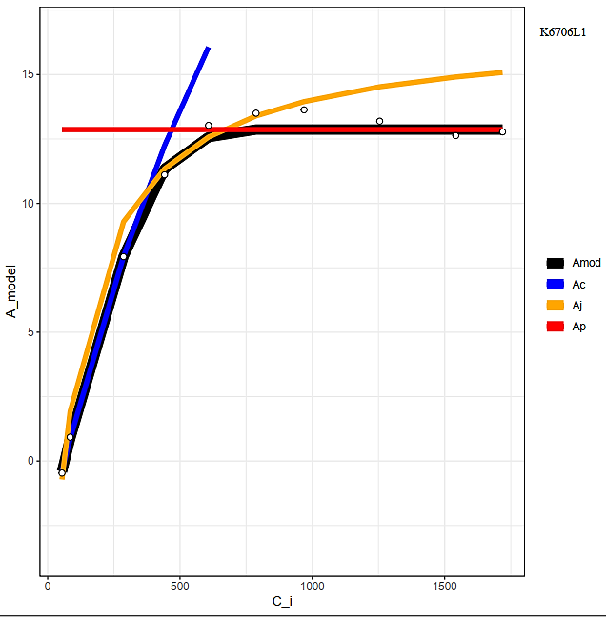
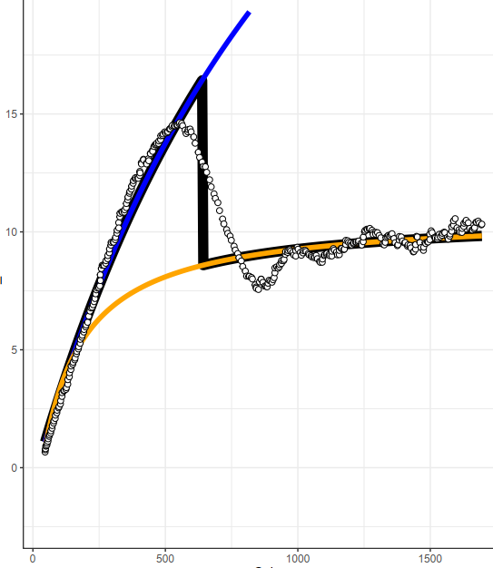
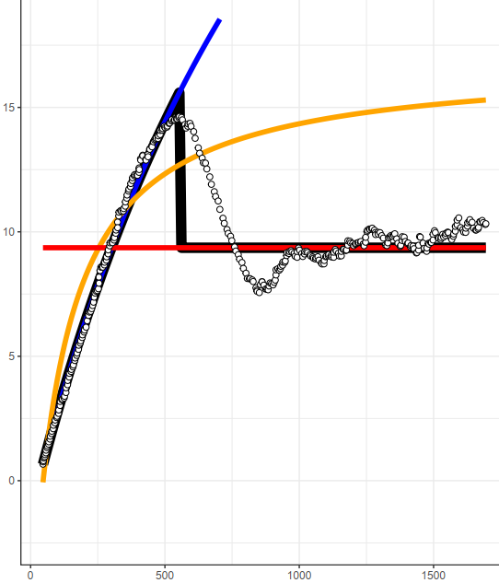
K6706L1
Without TPU
With TPU
Steady-State
Modeled A
DAT
Modeled A
$$C_{i}$$
$$C_{i}$$

Slide 11
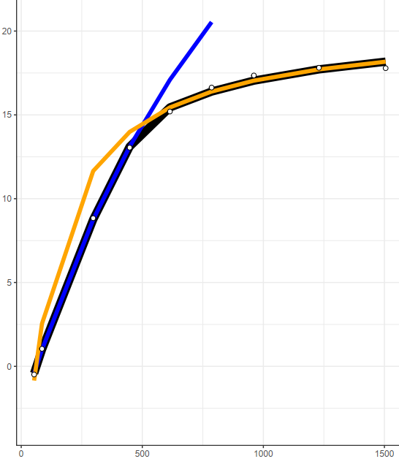
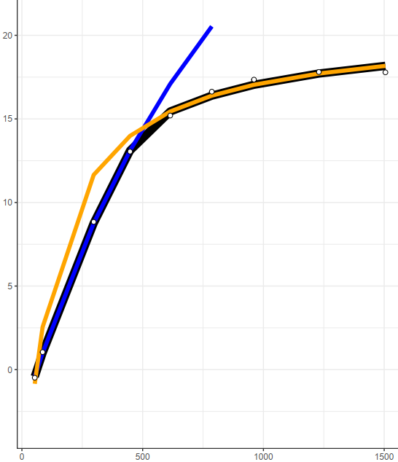
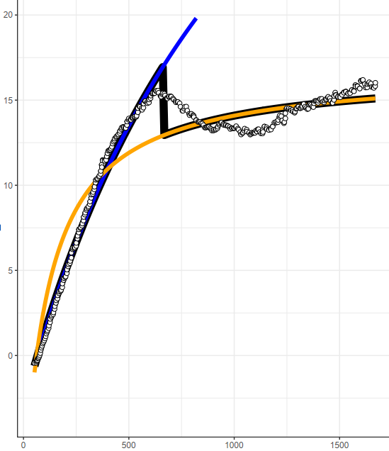
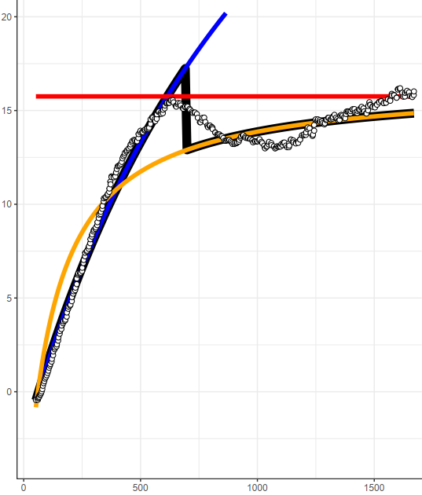
K6706L2
Without TPU
With TPU
Steady-State
Modeled A
DAT
Modeled A
$$C_{i}$$
$$C_{i}$$

Slide 12
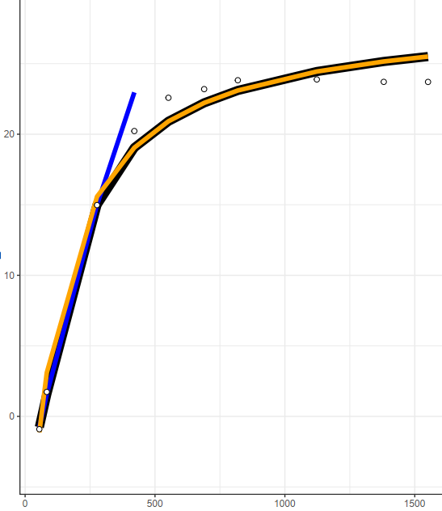
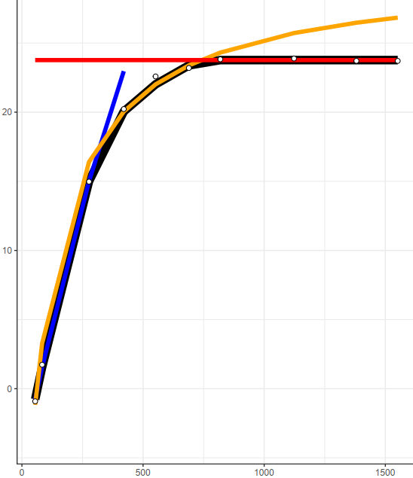
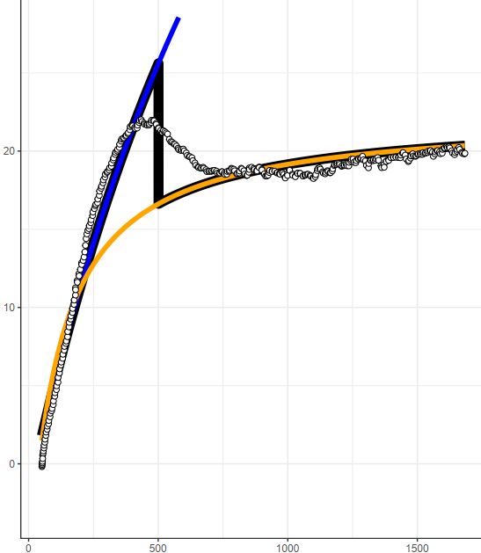
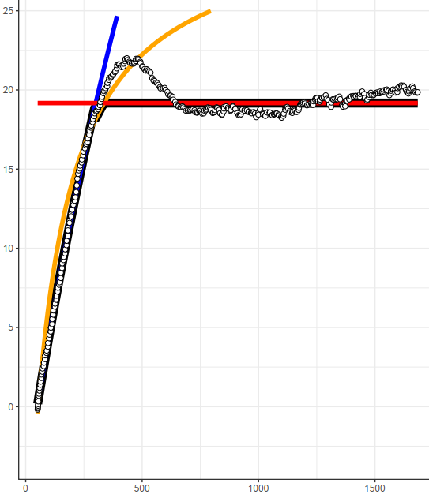
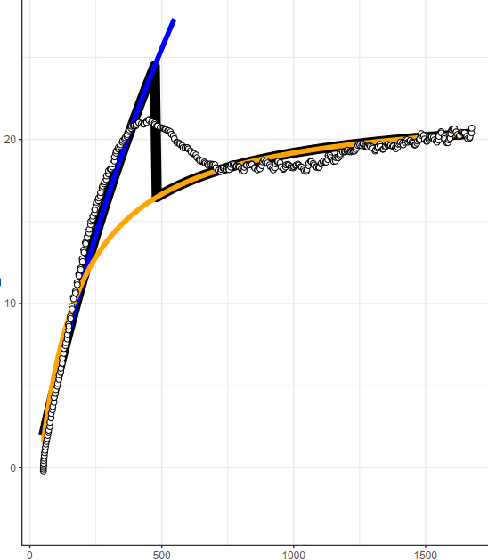
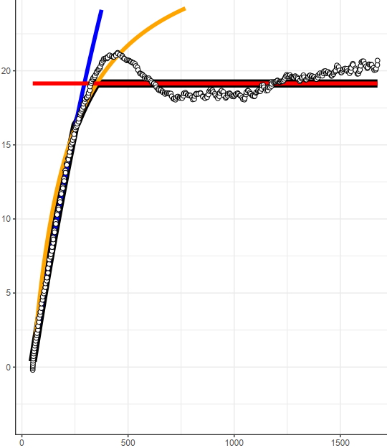


K6707L1
Without TPU
With TPU
Steady-State
Modeled A
Modeled A
DAT
Modeled A
$$C_{i}$$
$$C_{i}$$

Slide 13
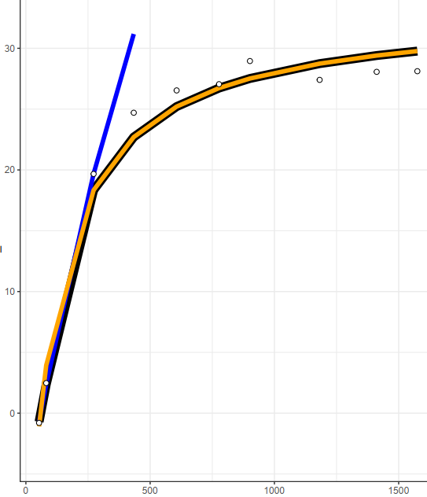
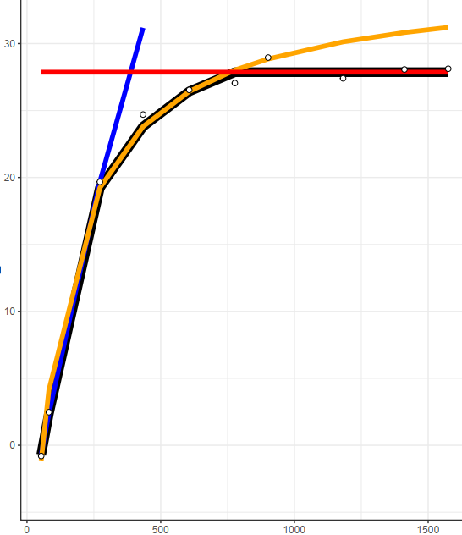
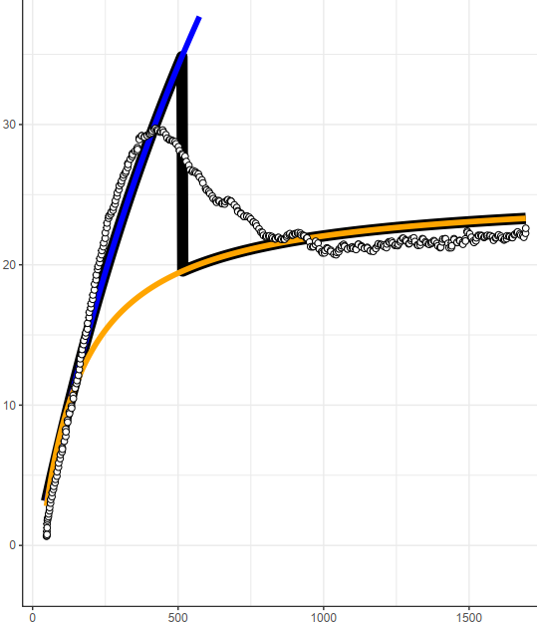
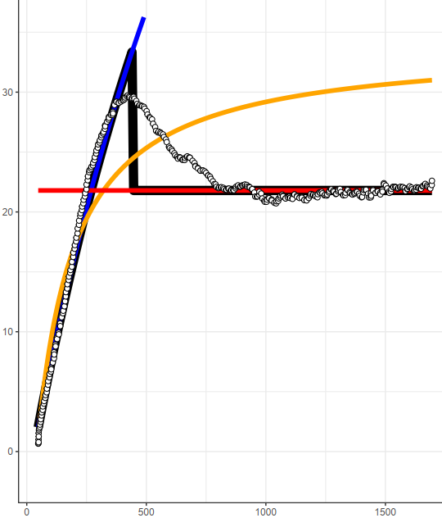
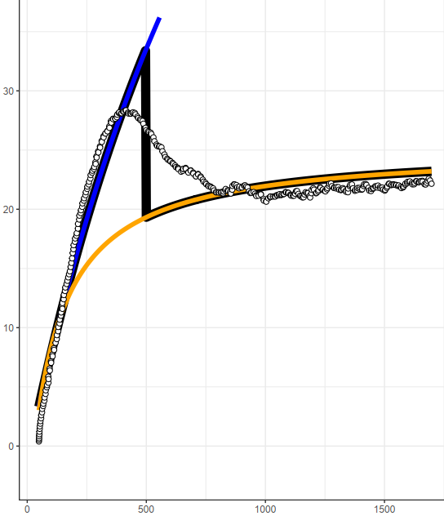
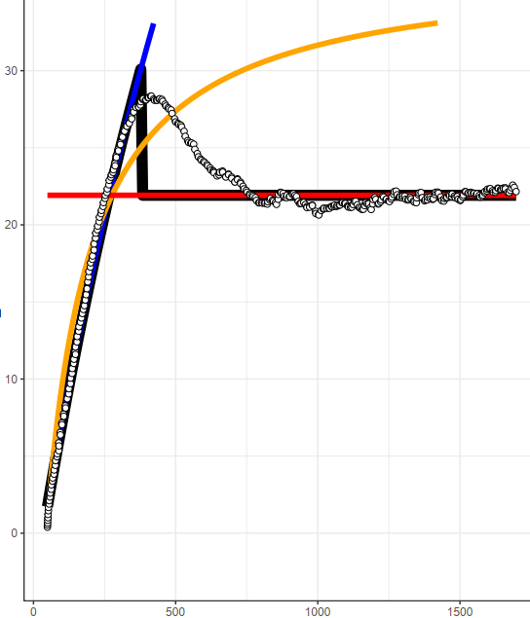
K6707L2
Without TPU
With TPU
Steady-State
Modeled A
Modeled A
DAT
Modeled A
$$C_{i}$$
$$C_{i}$$

Slide 14
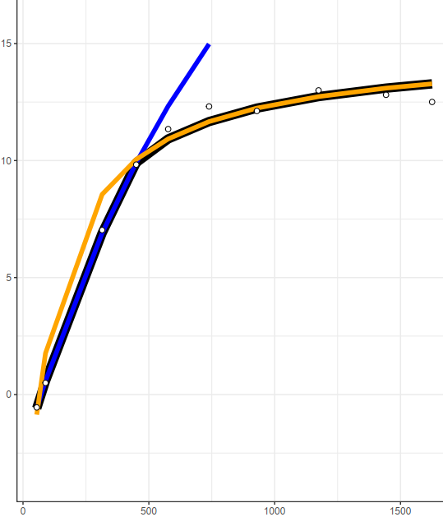

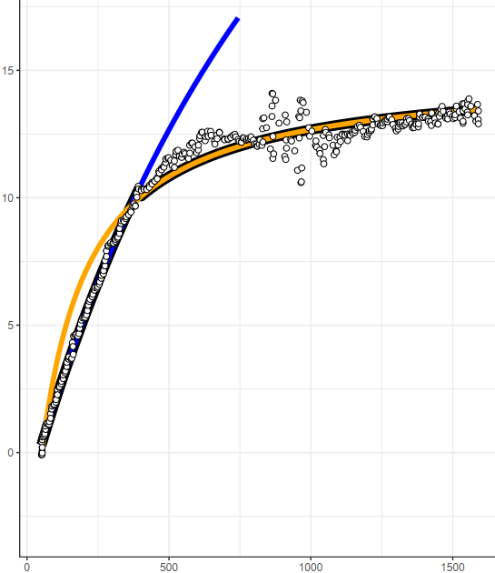
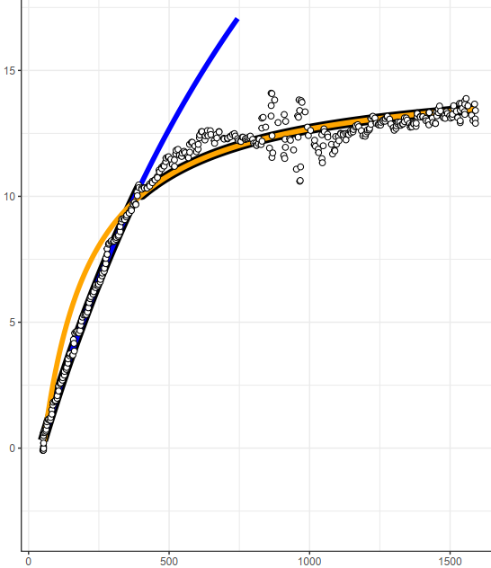
K6708L1
Without TPU
With TPU
Steady-State
Modeled A
DAT
Modeled A
$$C_{i}$$
$$C_{i}$$

Slide 15
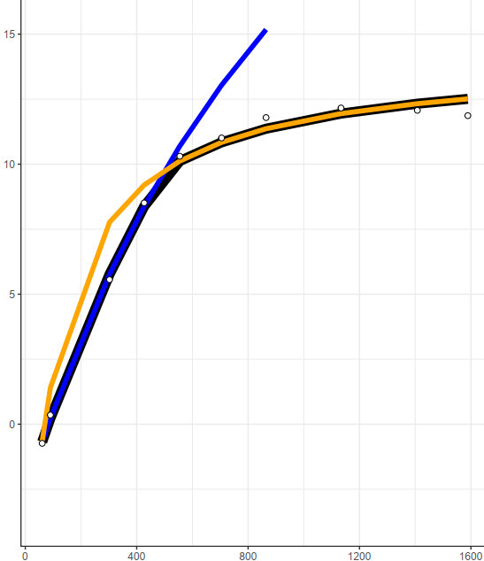
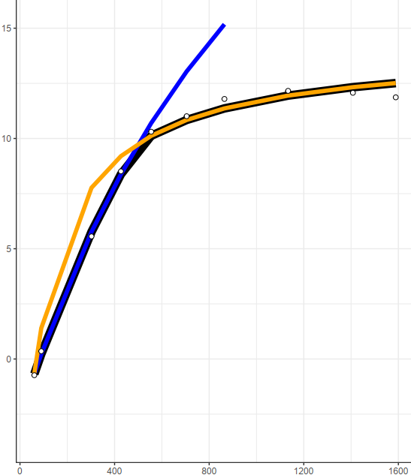


K6708L2
Without TPU
With TPU
Steady-State
Modeled A
DAT
Modeled A
$$C_{i}$$
$$C_{i}$$

Slide 16






K6709L2
Without TPU
With TPU
Steady-State
Modeled A
Modeled A
DAT
Modeled A
$$C_{i}$$
$$C_{i}$$

Slide 17




K6709L3
Without TPU
With TPU
Steady-State
Modeled A
DAT
Modeled A
$$C_{i}$$
$$C_{i}$$

Slide 18




K6709L6
Without TPU
With TPU
Steady-State
Modeled A
DAT
Modeled A
$$C_{i}$$
$$C_{i}$$

Slide 19




K6709L8
Without TPU
With TPU
Steady-State
Modeled A
DAT
Modeled A
$$C_{i}$$
$$C_{i}$$

Slide 20




K6713L1
Without TPU
With TPU
Steady-State
Modeled A
DAT
Modeled A
$$C_{i}$$
$$C_{i}$$

Slide 21




K6713L2
Without TPU
With TPU
Steady-State
Modeled A
DAT
Modeled A
$$C_{i}$$
$$C_{i}$$

Slide 22




K6713L3
Without TPU
With TPU
Steady-State
Modeled A
DAT
Modeled A
$$C_{i}$$
$$C_{i}$$

Slide 23




K6714L1
Without TPU
With TPU
Steady-State
Modeled A
DAT
Modeled A
$$C_{i}$$
$$C_{i}$$

Slide 24




K6714L2
Without TPU
With TPU
Steady-State
Modeled A
DAT
Modeled A
$$C_{i}$$
$$C_{i}$$

Slide 25






K6715L1
Without TPU
With TPU
Steady-State
Modeled A
Modeled A
DAT
Modeled A
$$C_{i}$$
$$C_{i}$$

Slide 26




K6715L2
Without TPU
With TPU
Steady-State
Modeled A
DAT
Modeled A
$$C_{i}$$
$$C_{i}$$

Slide 27




K6716L1
Without TPU
With TPU
Steady-State
Modeled A
DAT
Modeled A
$$C_{i}$$
$$C_{i}$$

Slide 28




K6716L2
Without TPU
With TPU
Steady-State
Modeled A
DAT
Modeled A
$$C_{i}$$
$$C_{i}$$

Slide 29




K6717L1
Without TPU
With TPU
Steady-State
Modeled A
DAT
Modeled A
$$C_{i}$$
$$C_{i}$$

Slide 30




K6717L2
Without TPU
With TPU
Steady-State
Modeled A
DAT
Modeled A
$$C_{i}$$
$$C_{i}$$

Slide 31




K6718L1
Without TPU
With TPU
Steady-State
Modeled A
DAT
Modeled A
$$C_{i}$$
$$C_{i}$$

Slide 32




K6718L2
Without TPU
With TPU
Steady-State
Modeled A
DAT
Modeled A
$$C_{i}$$
$$C_{i}$$

